Slide 1
Aardvark: Software for Behavioral Data Collection and Analysis
Harold Mills
December 2005

Slide 2
Old Aardvark Overview
Theodolite shore station data collection and analysis software
Developed at Cornell BRP in mid-1990’s for ATOC and LFA projects
Freely available

Slide 3
Old Aardvark Functions
Efficient theodolite and behavioral field data collection
Constrained document editing
Track visualization
Track statistics computation

Slide 4
Old Aardvark Limitations
Separate editor and viewer applications
Can’t combine data from multiple stations in the field
Runs only on older Macintoshes – no Windows or Mac OS X
Not readily extensible

Slide 5
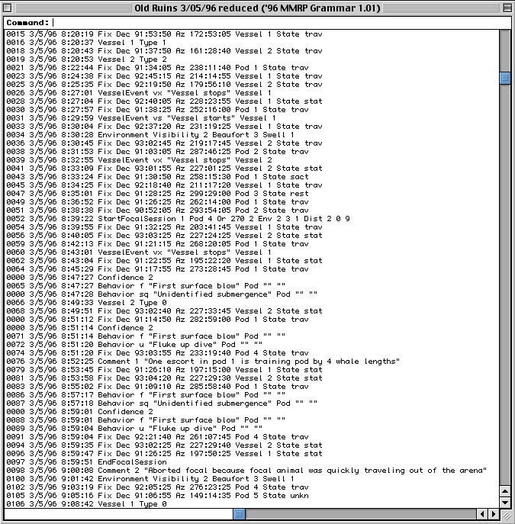
Old Aardvark Document

Slide 6
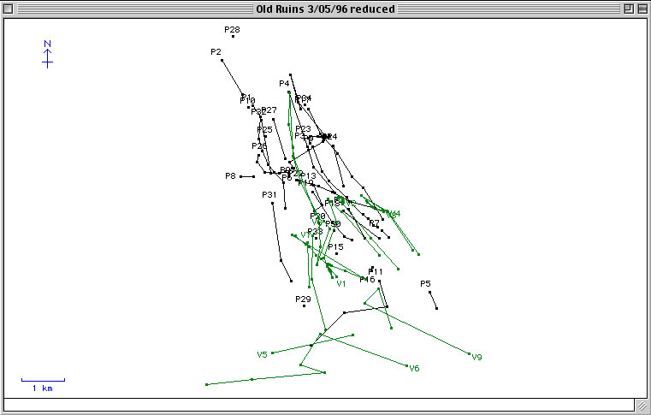
Old Aardvark Map View

Slide 7
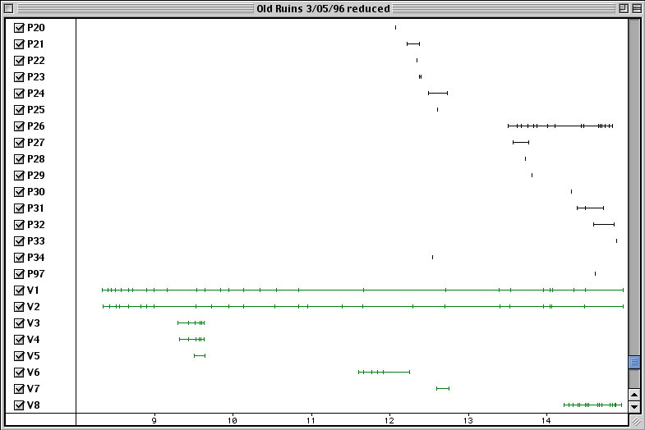
Old Aardvark Timeline View

Slide 8
New Aardvark Plans
More general behavioral data collection and analysis software
Cross-platform
Readily extensible
Open source

Slide 9
Improved Functions
Integrated editor and viewer
Multi-station communication in the field
Improved track visualization
New track statistics view

Slide 10
Aardvark Data
Observations
Track
Constructor
Tracks

Slide 11
Basic Aardvark System
Text
View
Map
View
Timeline
View
Statistical
View
Text/Theo
Input
Observations
Track
Constructor
Tracks
Key:
Data
Data Source
Observation Listener
Track Listener

Slide 12
Multi-station Aardvark System
Text
View
Map
View
Timeline
View
Statistical
View
Text/Theo
Input
Observations
Track
Constructor
Tracks
Network
Listener
Network
Broadcaster
Key:
Data
Data Source
Network
Observation Listener
Track Listener

Slide 13
Extension Architecture
Extension 1
Extension 2
Extension 4
Extension Point A
Extension 5
Extension Point C
Extension 6
Extension 3
Extension Point B

Slide 14
Aardvark Extension Architecture
Application
Document Grammar
MAST ’07 Grammar
Command Processor
MAST ’07 Commands
Instrument
Theodolite
Track View
Provider
Map View
Track View Type
Document View Provider
Timeline View
Text View

